Slide 1
PLANT DEPARTMENT
CHAPTER 3
Roselyn A. Naranjo, RPh, MPH USPF, College of Pharmacy www.roselynnaranjo.vze.com roselean@gmail.com

Slide 2
PRODUCTION CONTROL
Inventory Control
Purchasing
Monitor & record all materials in production & control the flow of raw materials & finished products. The stocks are checked periodically.
Purchase requisition items for the company both from local & imported sources
PRODUCTION
CONTROL
Planning & Scheduling
Coordinates with marketing for the supply of required products, plan & schedule the manufacture of the the product.

Slide 3
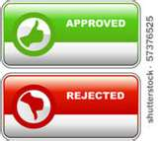
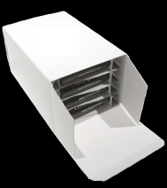
WAREHOUSE DIVISION
Raw material section
Quarantine Area
Approved for Use Area
Rejected Area
IN-PROCESS section
WAREHOUSE
DIVISION
Finished product
Packed, bottled
Boxes no label yet
Returned goods
Dispensing section

Slide 4
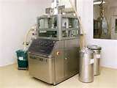
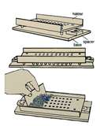
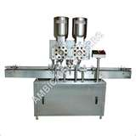
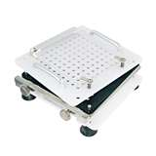
ENGINEERING & MAINTENANCE
Take charge of the maintainance of all machines
Electric line
Machines
Water line

Slide 5
PRODUCTION
Procedure for Manufacturing of a Product
Parent company abroad
prepares the
Master Formula
Name of the Product
Potency of the active ingredient
Batch Size
List of ingredients,
Specifications & Code numbers
Quantity of each ingredients
Signature of the people involved in the preparation

Slide 6
PRODUCTION
Quality Control Head
If the Master Formula is NOT the actual amount to be manufactured

Slide 7
PRODUCTION
Production Control Head
Manufacturing Order
Date of Production
Manufacturing Order Number

Slide 8
PRODUCTION
Production Control Head
Manufacturing Order
+
Finishing Order
Warehouse
Production
dispensing
manufacturing

Slide 9
PRODUCTION
DISPENSING PHARMACIST
Manufacturing Area
transfers
or
Packaging Section
Compounds the product
✓
checked
Weighs and measures the ingredients
✓
tested
✓
assayed
STANDARD PROCEDURE

Slide 10
PRODUCTION
Quality Control
Packaging Section
Warehouse
Compounded
product
bottled
stripped

Slide 11
PRODUCTION
Quality Control
Warehouse Finished Product Section

Slide 12
CLASSIFICATION OF PHARMACEUTICAL PREPARATIONS
Refer to pages 22, 23 and 24
Prepare for a quiz

